Slide 1

Heart Failure Prediction
By: Brian Rodriguez and Juliana Garcia

Slide 2

Content
Introduction
Data Summary
Data Cleaning
KNN Imputation
Managing Categorical Variables
Data Statistics
Data Visualization
ANOVA Test On Cholesterol
Hypothesis Testing Using Pairwise Proportion Test
Model Creation
Logistic Regression

Slide 3

Introduction
Dataset Overview
11 clinical features, binary label: “Heart Disease”
918 instances (no duplicates)
Purpose
Predict “Heart Disease” using 11 features
Relevance
Cardiovascular disease is the #1 cause of death globally
Early detection can save lives
Source
fedesoriano. (September 2021). Heart Failure Prediction Dataset. Retrieved [Date Retrieved] from https://www.kaggle.com/fedesoriano/heart-failure-prediction.

Slide 4
Data Summary
Categorical Variables
"Continuous" Variables
Variable Name | Type of Variable
Sex | Binary
FastingBS | Binary
RestingECG | Nominal, (3 Unique values), NOT Mutually Exclusive
ExerciseAngina | Binary
ST_Slope | Ordinal, (3 Unique Values)
ChestPainType | Nominal, (4 Unique Values)
Variable Name | Type of Variable
Age | Integer (50 Unique)
RestingBP (Blood Pressure) | Integer (67 Unique)
Cholesterol | Integer (222 Unique)
MaxHR (Heart Rate) | Integer (119 Unique)
Oldpeak | Continuous (53 Unique)

Slide 5
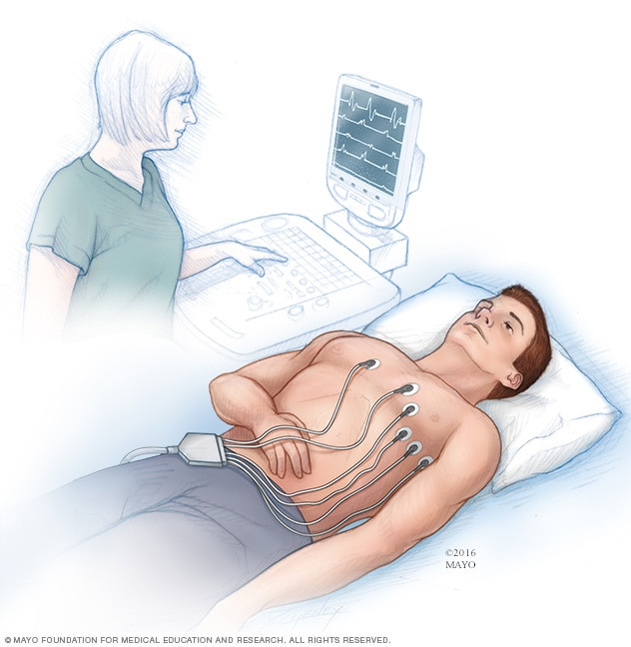
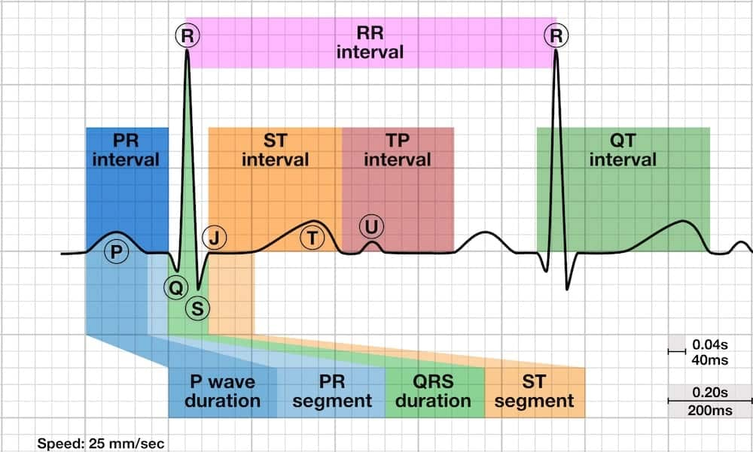
Data Summary: Electrocardiogram (ECG) Variables
RestingECG:
Normal – Normal ECG Wave
ST – Having ST-T Wave abnormality (may allude to LVH)
LVH – Showing Left Ventricular Hypertrophy (problem with the heart)
ST_Slope: ​
Upsloping, Flat, Down
Oldpeak: ​
Compare peak between exercising and rest
Illustration of ECG
Illustration of ECG Reading

Slide 6
Data Cleaning
Missing values for Cholesterol
KNN Imputation
Creation of "Missing Cholesterol" Attribute
Multicategorical Variables
Transform nominal to one hot encoding (RestingECG, ChestPainType)
Transform ordinal category to integers (ST_slope)
Remove "Dummy One Hot Variable"

Slide 7
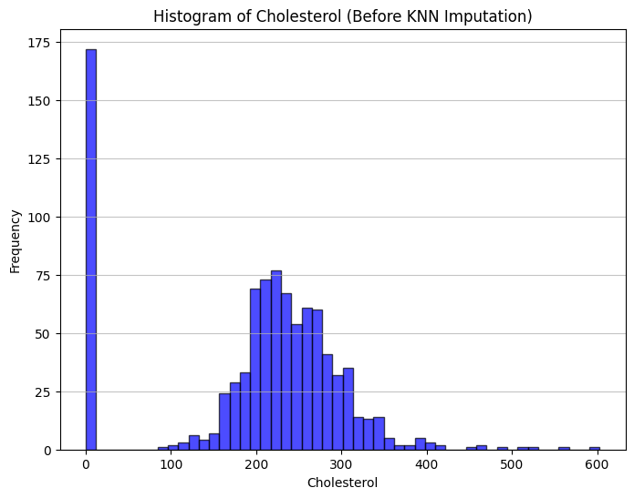
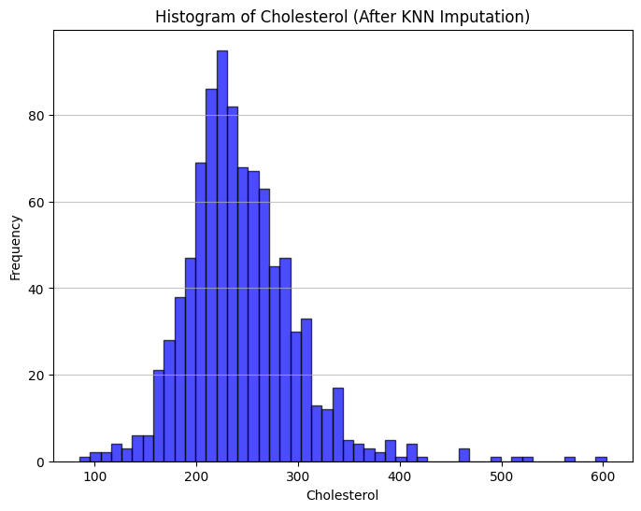
KNN Imputation On Cholesterol

Slide 8
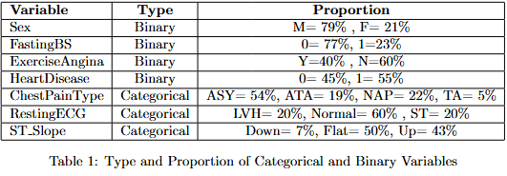
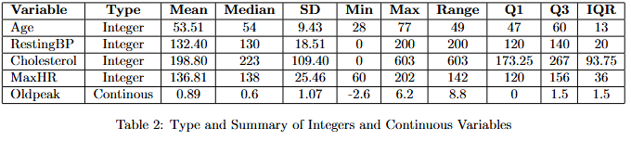
Data Statistics

Slide 9
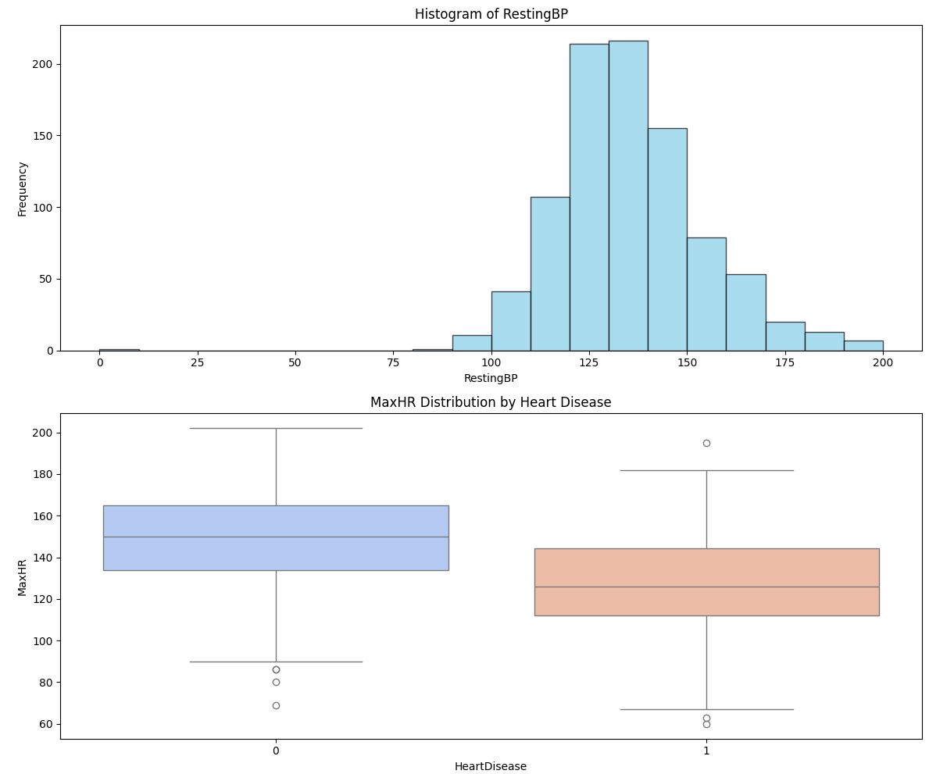
Data Visualization

Slide 10
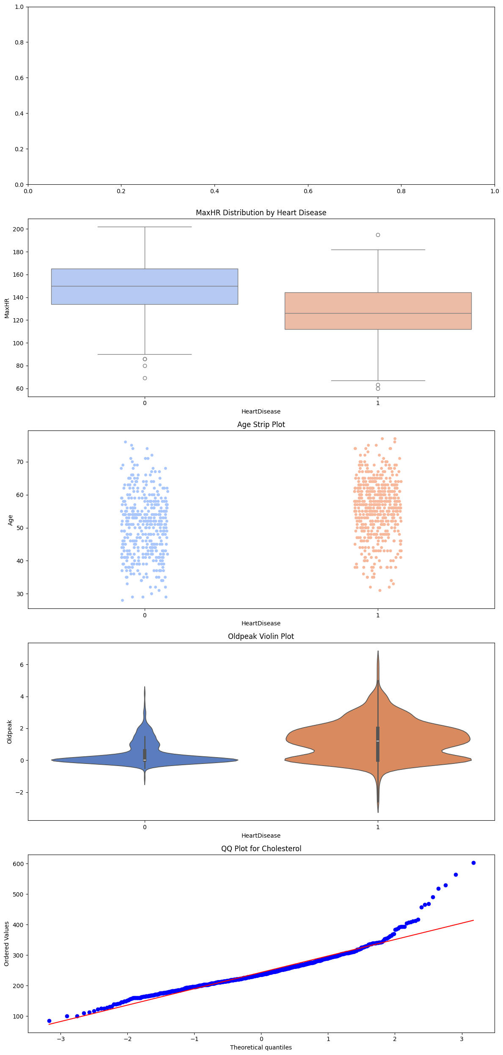
Data Visualization

Slide 11
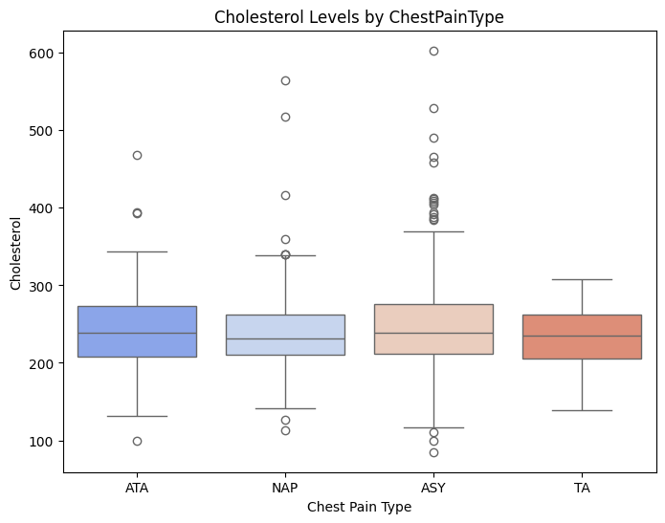
ANOVA Test for Cholesterol by Chest Pain Type
Purpose: To test if mean Cholesterol levels differ significantly across the four Chest Pain Types (ASY, ATA, NAP, TA).
Method: Performed one-way ANOVA on one-hot encoded data.
Results:
F-statistic: 1.95
P-value: 0.119
Conclusion: No significant differences in mean Cholesterol levels across Chest Pain Types (p > 0.05).

Slide 12
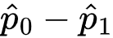
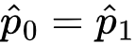
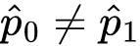
Proportion Test – Two Independent Samples
Purpose: Check if the proportion of heart disease in two independent groups
(M/)
Estimator:
H0:
H1: ​
Group | t stat | P-value | Reject h0 | Estimator | Lower CI | Upper CI
Sex (M=0 / F=1) | 9.2395 | 2.474e-20 | True | 0.372148 | 0.30104 | 0.44
Fasting (T/F) | -8.115 | 4.842e-16 | True | -0.315018 | -0.380561 | -0.249475
ExerciseAngina (T/F) | -15.004 | 6.867e-51 | True | -0.501935 | -0.555859 | -0.448011
ChestPainType_ATA (T/F) | 12.1636 | 4.853e-34 | True | 0.510465 | 0.448585 | 0.572345
ChestPainType_NAP (T/F) | 6.5200 | 7.028e-11 | True | 0.258305 | 0.183382 | 0.333228
ChestPainType_TA (T/F) | 1.6531 | 0.098 | False | 0.124345 | -0.022660 | 0.271349
RestingECG_LVH (T/F) | -0.338 | 0.73 | False | -0.013761 | -0.093319 | 0.065797
RestingECG_ST (T/F) | -3.121 | 1.801e-03 | True | -0.129563 | -0.208030 | -0.051096
MissingCholesterolNum (T/F) | -9.627 | 6.138630e-22 | True | -0.405829 | -0.465870 | -0.345788

Slide 13
Model Creation
Logistic regression

Slide 14
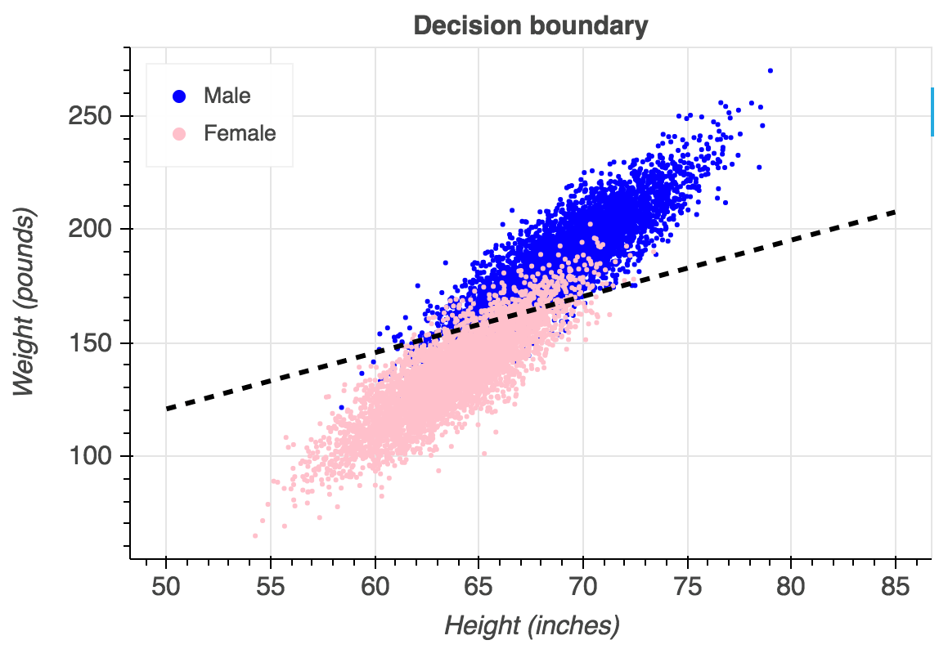
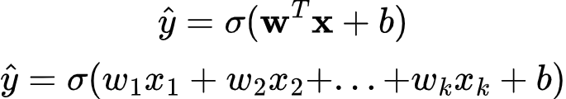
Logistic Regression (Quick Review)
Logistic Regression: Used to predict binary (or categorical variables)
NOT REGRESSION
Assumptions:
Independence of observations
Linearity in the logit for continuous variables
(linear boundary can be used to separate classes)
Absence of multicollinearity (VIF)
Lack of strongly influential outliers (Cooks Distance)
Classifier:
https://towardsdatascience.com/understanding-logistic-regression-step-by-step-704a78be7e0a

Slide 15
Model Development Overview
Split the dataset - Training: 80%, Testing: 20%
Check for multicollinearity (VIF < 5)
Train logistic regression model on all features
Find Important Features (significant p-values)
Find outliers (large cook's distance)
Train Second logistic regression model on only important features
Train Third logistic regression model on only important features and no outliers

Slide 16
Variance Inflation Factor And Principle Component Analysis (PCA)
Original VIF Values
VIF Values After PCA
Feature | VIF
RestingBP | 48.683078
Age | 33.926146
MaxHR | 24.624629
Cholesterol | 19.600627
ST_Slope | 3.357979
ExerciseAngina | 2.607138
Oldpeak | 2.547320
ChestPainType_ATA | 1.840213
ChestPainType_NAP | 1.625341
MissingCholesterolNum | 1.539673
FastingBS | 1.531498
RestingECG_LVH | 1.456012
Sex | 1.400339
RestingECG_ST | 1.397262
ChestPainType_TA | 1.183106
Feature | VIF
PC1 | 1.25
PC2 | 1.071202
PC3 | 1.098807
PC4 | 1.111457
ST_Slope | 3.146648
ExerciseAngina | 2.285387
Oldpeak | 2.505602
ChestPainType_ATA | 1.275813
ChestPainType_NAP | 1.269164
MissingCholesterolNum | 1.490438
FastingBS | 1.501393
RestingECG_LVH | 1.371167
Sex | 1.308819
RestingECG_ST | 1.333397
ChestPainType_TA | 1.111809
Apply PCA on high VIF features

Slide 17
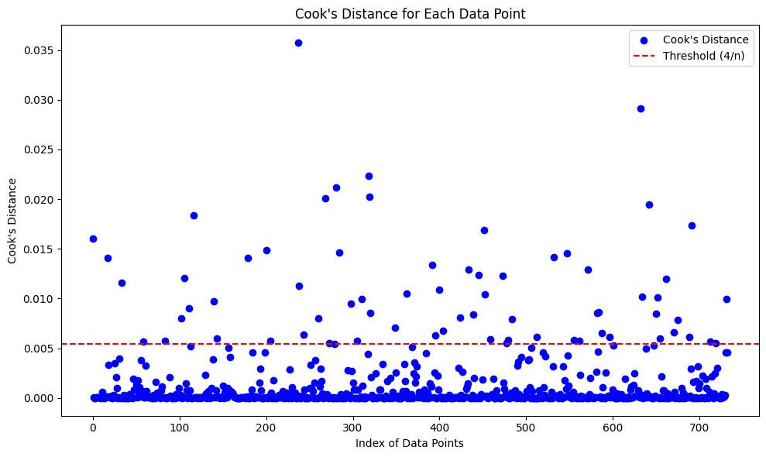
Cook's Distance
Using the threshold: 4/733, 62 outliers discovered

Slide 18
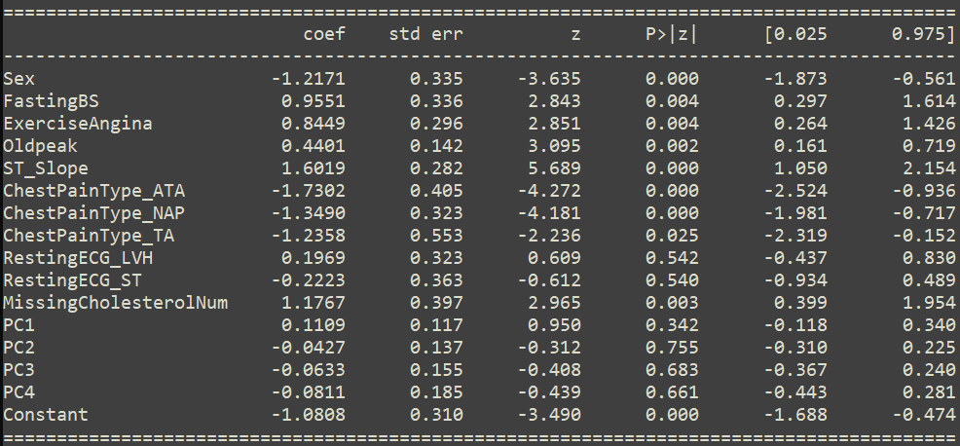
Model Training: Important Features
Significant Features (p-value < 0.05)
Sex
FastingBS
ExerciseAngina
Oldpeak
ST_Slope
ChestPainType_ATA
ChestPainType_TA
MissingCholestorolNum
Constant
Coefficients Info of Model With All features

Slide 19
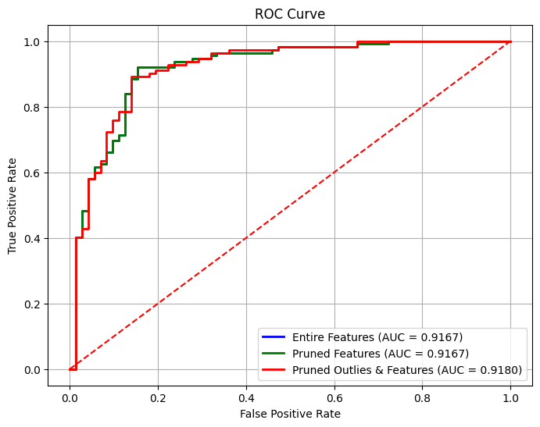
Comparing Logistic Regression Models
All feature model and Pruned Features are not significantly different – Identical Performance & VERY Similar Weights
Slight Improvement when pruning outliers
Models | Accuracy | Precision | Recall | F-score
Entire Features | 0.8696 | 0.90 | 0.88 | 0.89
Pruned Features | 0.8696 | 0.90 | 0.88 | 0.89
Pruned Outliers & Features | 0.8750 | 0.91 | 0.88 | 0.90

Slide 20
Conclusion
Gave a brief overview of heart dataset attributes and statistics
Explained Cleaning
Show visualization of some notable variables
Conducted ANOVA test comparing the average Cholesterol between groups of different chest pain
Conducted Two Independent Sample Proportion Test Comparing Binary Variables to Class Label
Trained and Displayed Results of Logistic Regression On Dataset
Slight Model Improvement When Removing Outliers

Slide 21

End

